Slide 1
Finding Your Way Children and Family Mental Health
Website: www.theacornfamily.co.uk
Email: info@theacornfamily.co.uk
Twitter: @findingyourway6
Facebook: findingyourway6
By Kay Brophy

Slide 2
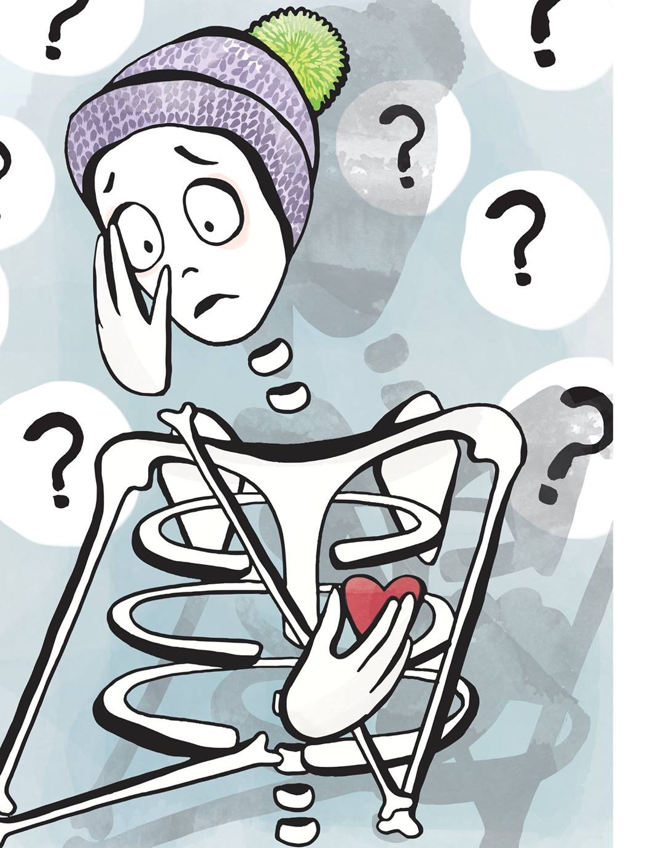
Mental Health in the Community
WARNING!
CAUTION!
BEWARE!
RISK!
What do you feel?
How do your children/family feel?

Slide 3
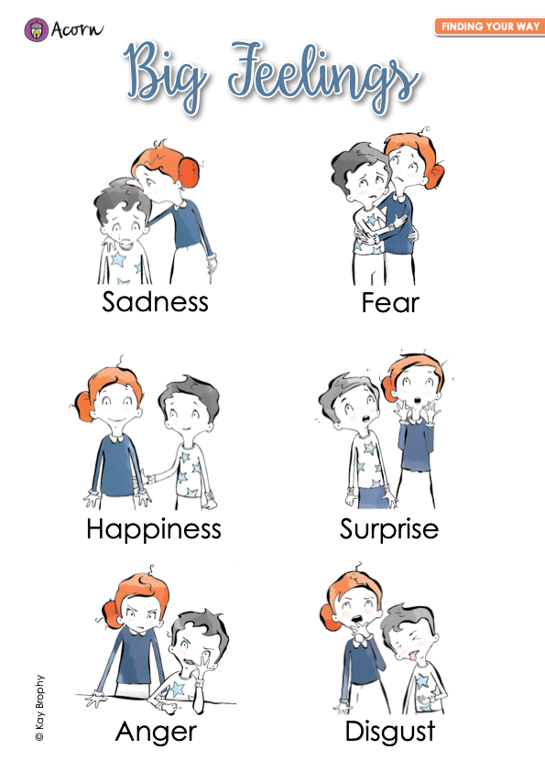
Psychology – Emotions
6 core emotions;
Fear
Sadness
Happiness
Anger
Surprise
Disgust

Slide 4
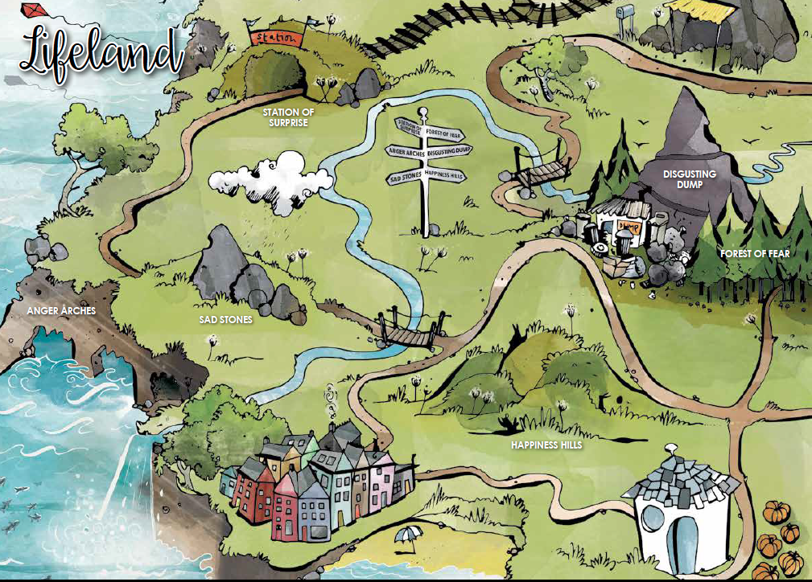
Lifeland

Slide 5
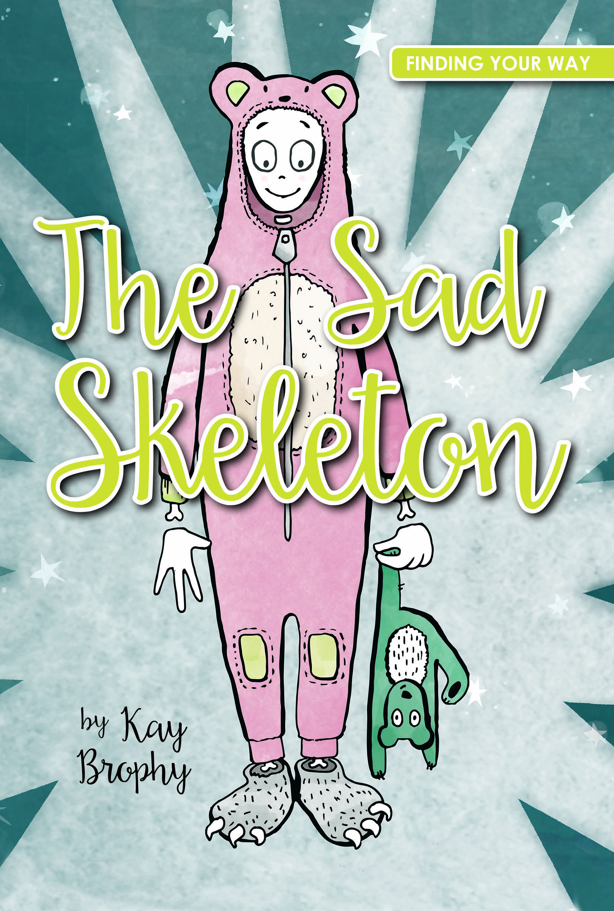
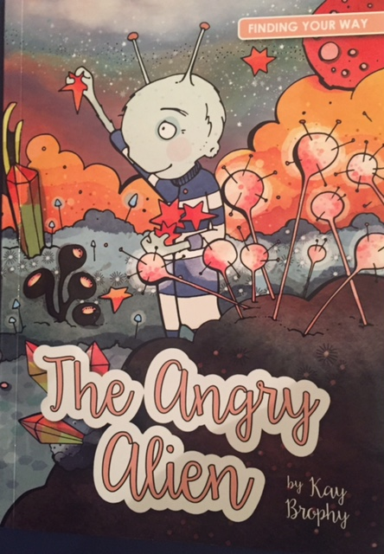
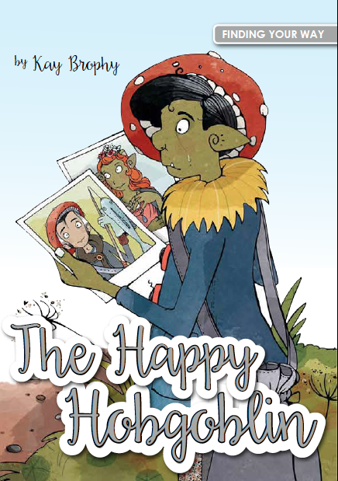
Finding Your Way Books
www.theacornfamily.co.uk

Slide 6
Safeguarding/Child Protection
Is there an immediate risk of harm?
If ‘yes’ get help straight away.
Who to talk to confidentially:
School
GP
Police
Social Services
Counsellor

Slide 7
Useful Resources/Websites for Children, Young People and Families
www.youngminds.org.uk
https://www.childline.org.uk/
https://www.rethink.org/
https://www.themix.org.uk/
https://papyrus-uk.org/
www.theacornfamily.co.uk

